Slide 1
DRDC project: Dielectric detection using an active SRR sensor
Yutong Zhao
Nov 5th 2018

Slide 2
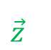
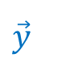
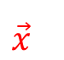
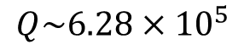
(a)
Sensor design
(b)
Spectrum
SA
$$Q\sim 6.28×{10}^{5}$$
Measure
Gaussian
Lorentzian
(c)
Device setup
(d)
$$\vec{z}$$
Z stage
$$\vec{x}$$
$$\vec{y}$$
Sample
X-Y stage

Slide 3
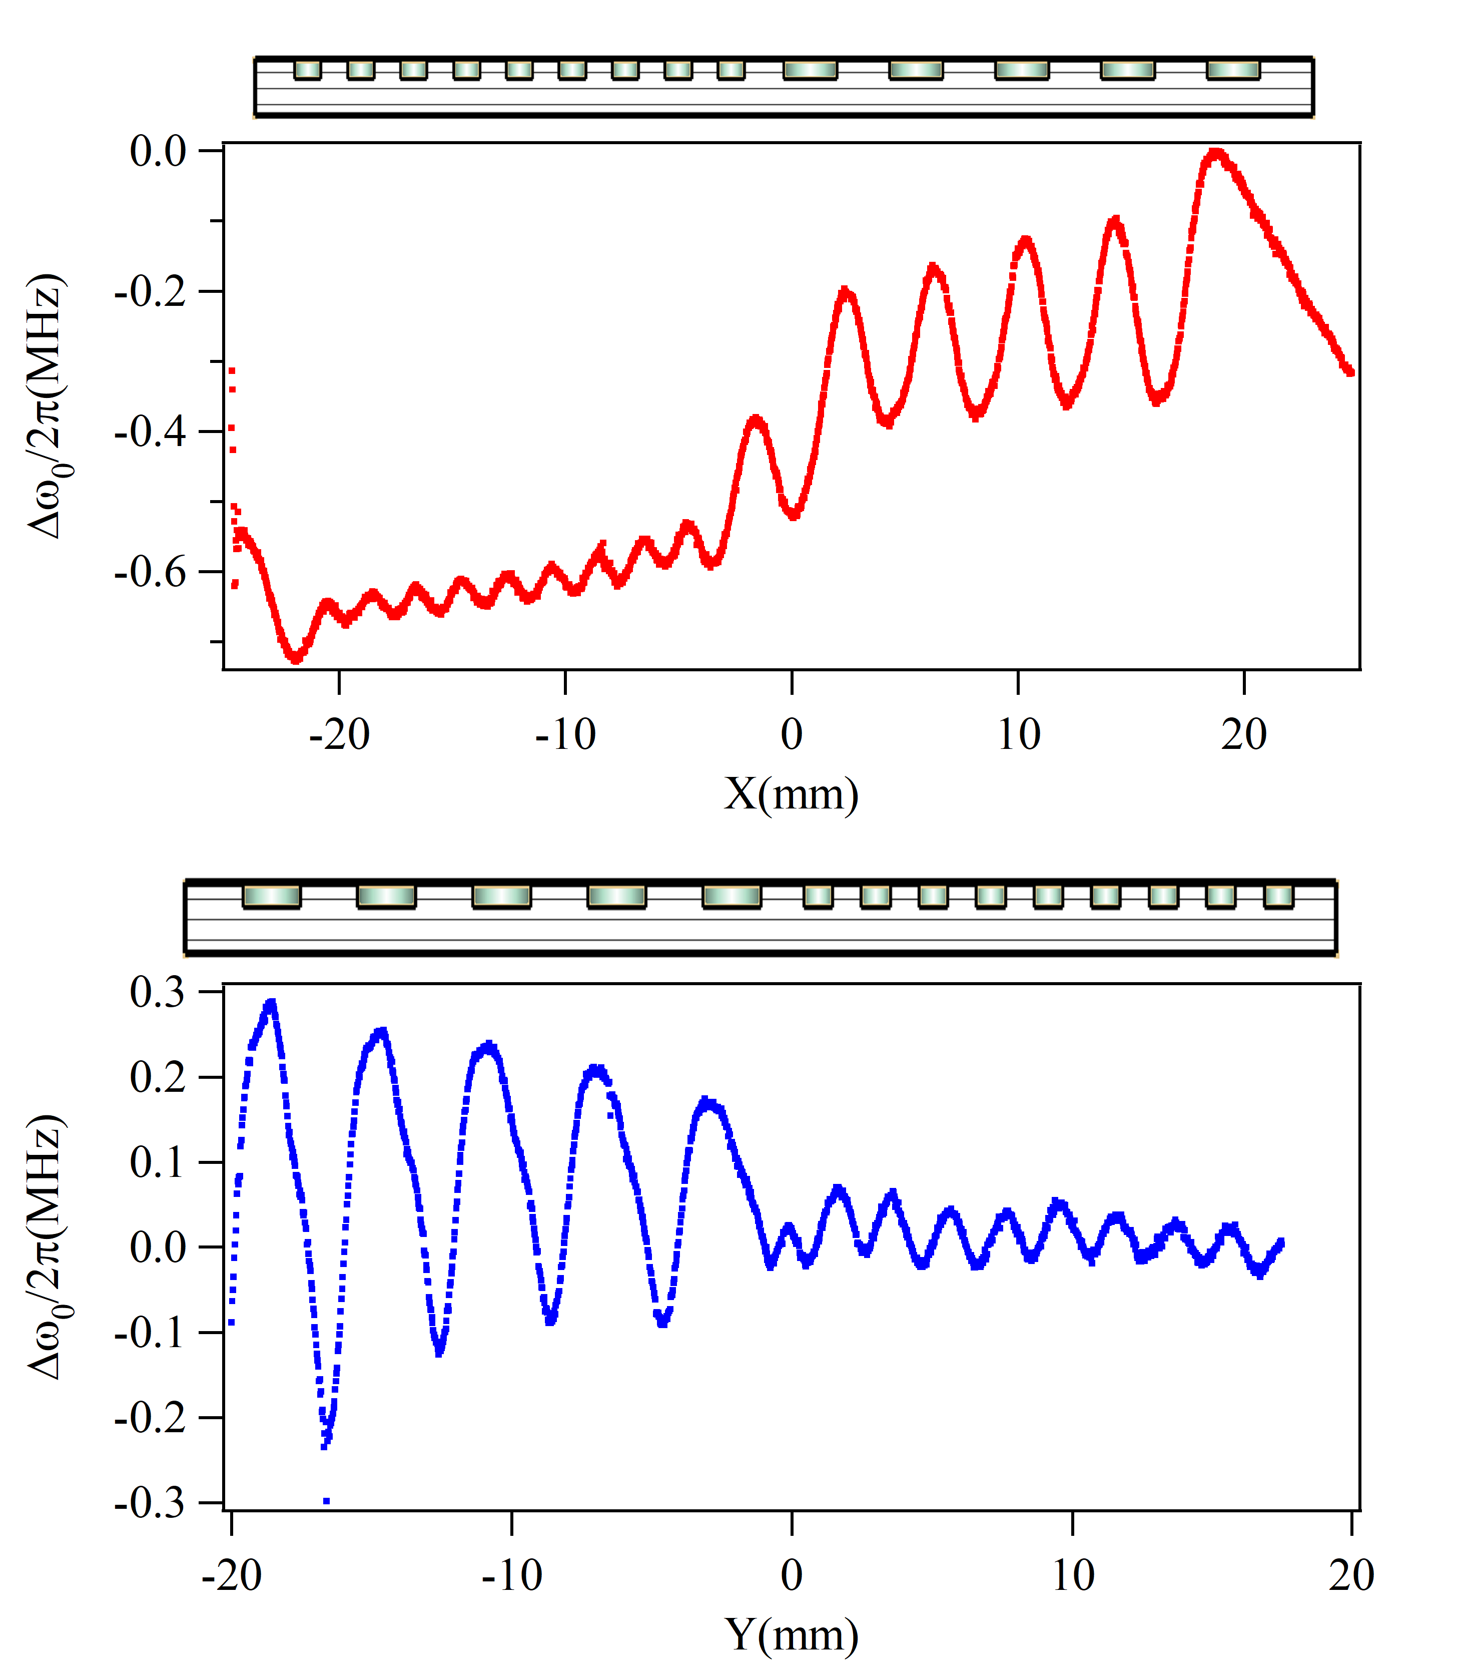
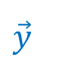
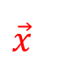
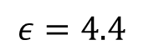
$$\vec{x}$$
$$\vec{y}$$
FR-4 tester
$$ε=4.4$$

Slide 4
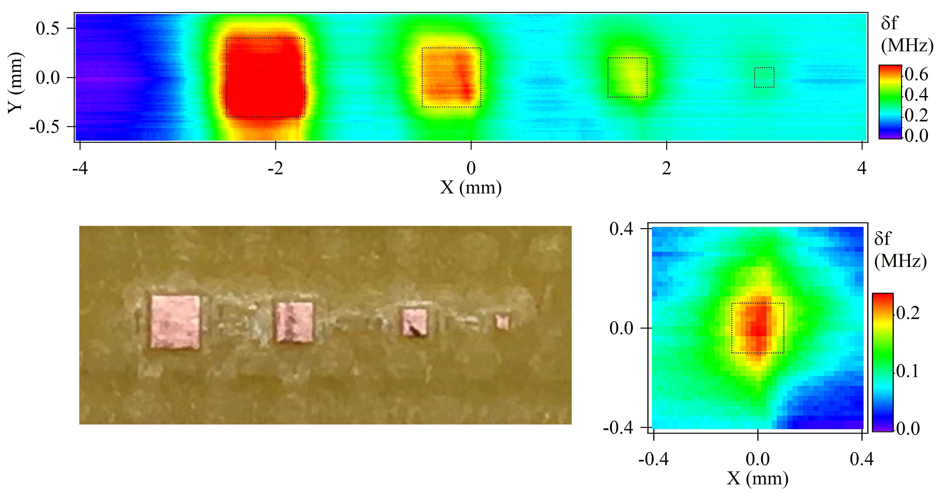
Dielectric imaging of metal (copper)
Optical image
Zoomed in imaging of 0.2 mm square
FR-4 substrate
0.8mm
0.6mm
0.4mm
0.2mm
Copper top layer

Slide 5
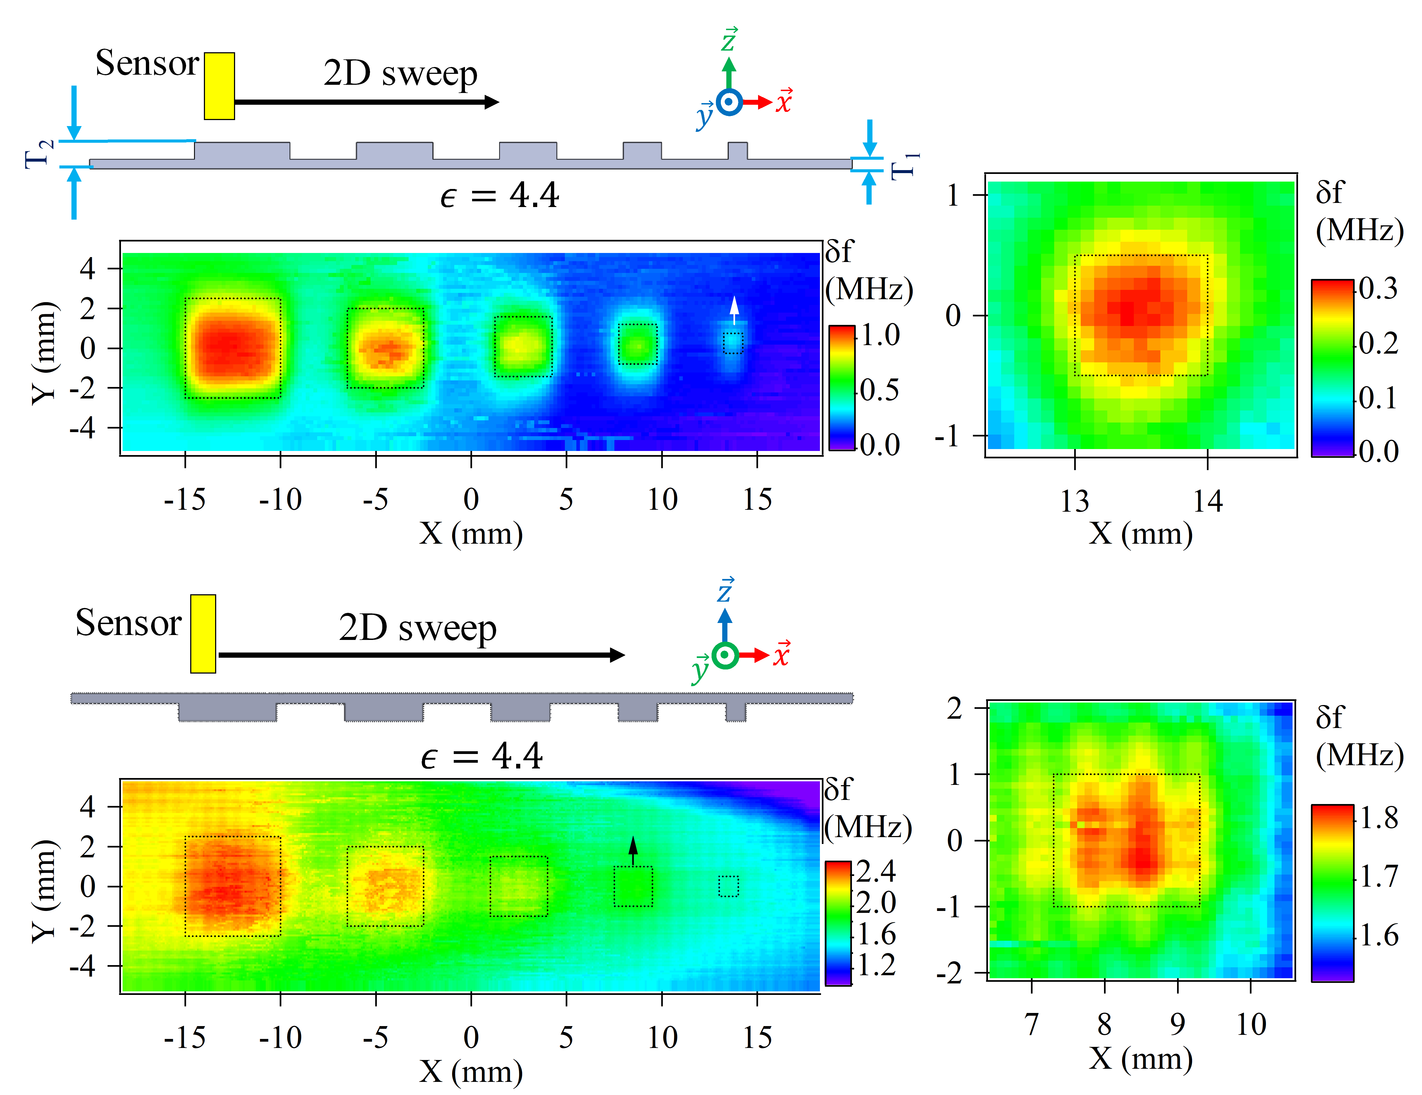
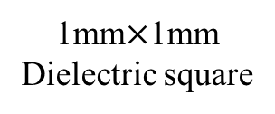
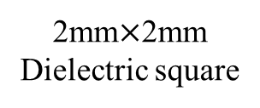
1mm$×$1mm
Dielectric square
Touchless
imaging
2mm$×$2mm
Dielectric square
Penetration
imaging

Slide 6
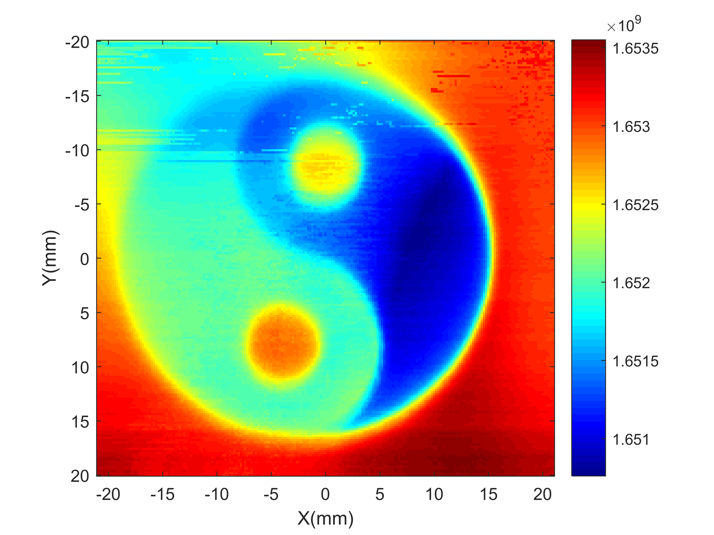
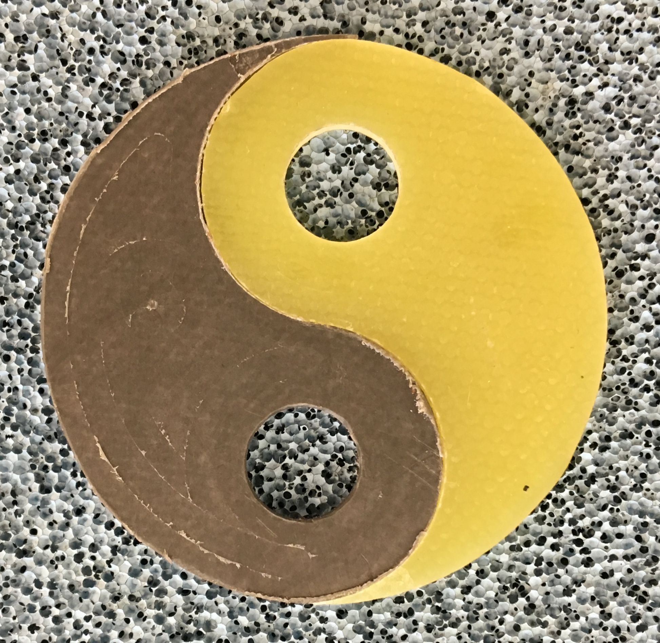
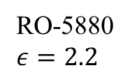
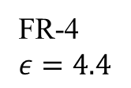
Optical image
Dielectric image
FR-4
$$ε=4.4$$
RO-5880
$$ε=2.2$$

Slide 7
Long distance coupling between 2 SRRs

Slide 8

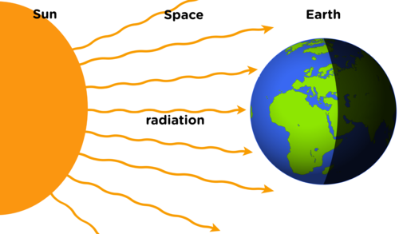
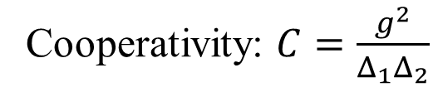
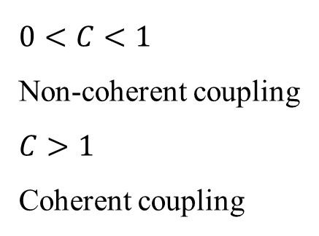
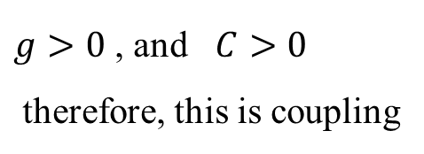
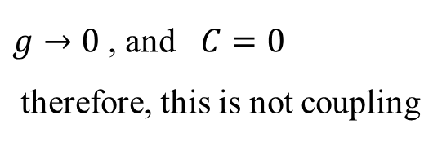
What is coupling?
Energy exchange between two systems:
1
2
Cooperativity: $C=\frac{g^{2}}{Δ_{1}Δ_{2}}$
1
2
R
$g→0$ , and $C=0$
therefore, this is not coupling
L
$0<C<1$
Non-coherent coupling
$C>1$
Coherent coupling
$g>0$ , and $C>0$
therefore, this is coupling
C

Slide 9
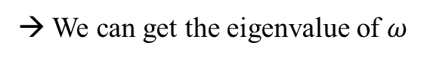
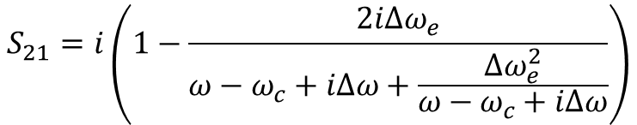
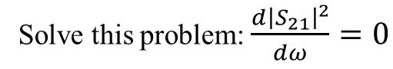
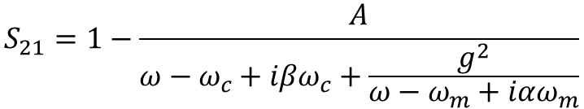
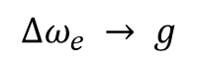
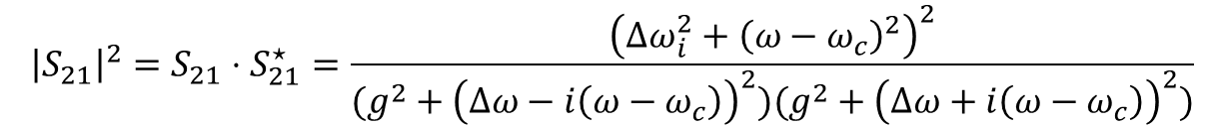
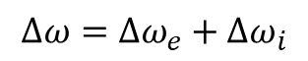
Why there is no Rabi-splitting?
$$S_{21}=1−\frac{A}{ω−ω_{c}+iβω_{c}+\frac{g^{2}}{ω−ω_{m}+iαω_{m}}}$$
Magnons coupling with cavity photons
$$S_{21}=i\left(1−\frac{2iΔω_{e}}{ω−ω_{c}+iΔω+\frac{{Δω}_{e}^{2}}{ω−ω_{c}+iΔω}}\right)$$
Two identical SRR coupled through transmission line
$$Δω=Δω_{e}+{Δω}_{i}$$
$$Δω_{e} → g$$
$${\left|S_{21}\right|}^{2}=S_{21}⋅S_{21}^{⋆}=\frac{{\left({Δω}_{i}^{2}+{\left(ω−ω_{c}\right)}^{2}\right)}^{2}}{(g^{2}+{\left(Δω−i\left(ω−ω_{c}\right)\right)}^{2})(g^{2}+{\left(Δω+i\left(ω−ω_{c}\right)\right)}^{2})}$$
Solve this problem: $\frac{d{\left|S_{21}\right|}^{2}}{dω}=0$
→ We can get the eigenvalue of $ω$

Slide 10
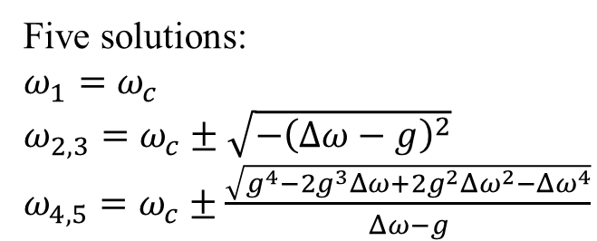
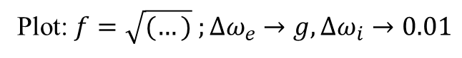
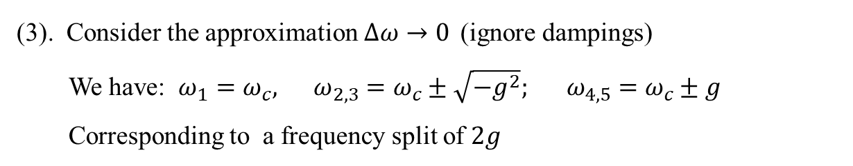
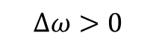
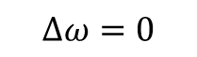
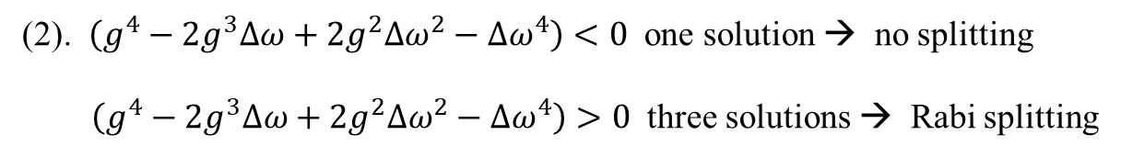
Why there is not Rabi-splitting? (2)
Five solutions:
$ω_{1}=ω_{c}$
$ω_{2,3}=ω_{c}±\sqrt{−{\left(Δω−g\right)}^{2}}$
$ω_{4,5}=ω_{c}±\frac{\sqrt{g^{4}−2g^{3}Δω+2g^{2}Δω^{2}−Δω^{4}}}{Δω−g}$
Plot: $f=\sqrt{(…)} ;Δω_{e}→g,Δω_{i}→0.01$
$$Δω>0$$
(1). $−{\left(Δω−g\right)}^{2}$ always smaller than zero → $ω_{2,3}$ have no physical meaning
(2). $\left(g^{4}−2g^{3}Δω+2g^{2}Δω^{2}−Δω^{4}\right)<0$ one solution → no splitting
$\left(g^{4}−2g^{3}Δω+2g^{2}Δω^{2}−Δω^{4}\right)>0$ three solutions → Rabi splitting
$$Δω=0$$
(3). Consider the approximation$Δω→0$ (ignore dampings)
We have: $ω_{1}=ω_{c}, ω_{2,3}=ω_{c}±\sqrt{−g^{2}}; ω_{4,5}=ω_{c}±g$
Corresponding to a frequency split of $2g$
Notes:
Solution of g is complicated.

Slide 11
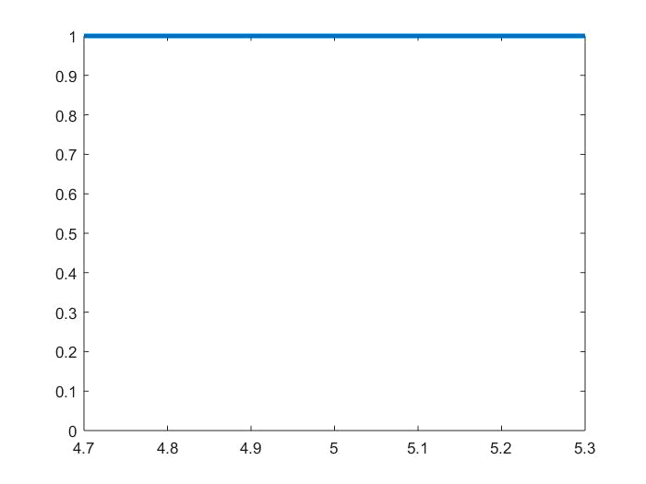
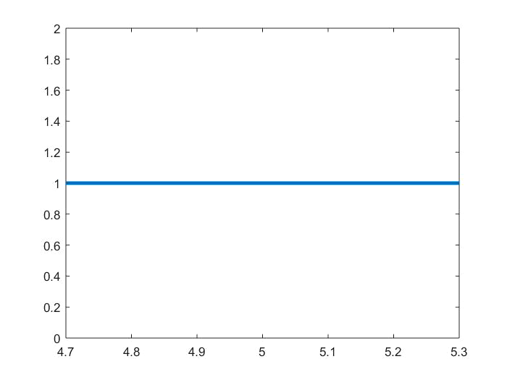
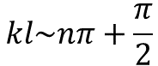
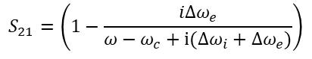
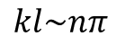
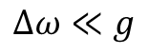
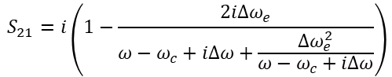
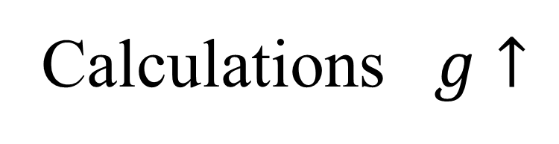
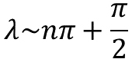

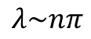
Calculations $g↑$
$$S_{21}=i\left(1−\frac{2iΔω_{e}}{ω−ω_{c}+iΔω+\frac{{Δω}_{e}^{2}}{ω−ω_{c}+iΔω}}\right)$$
$$S_{21}=\left(1−\frac{iΔω_{e}}{ω−ω_{c}+i(Δω_{i}+Δω_{e})}\right)$$
$$kl\sim nπ+\frac{π}{2}$$
$$kl\sim nπ$$
$$Δω≪g$$
$$λ\sim nπ+\frac{π}{2}$$
$$λ\sim nπ$$
$$Δω≪g$$

Slide 12
Next step:
Using two YIG spheres to realize the long distance coupling between magnons.

Slide 13
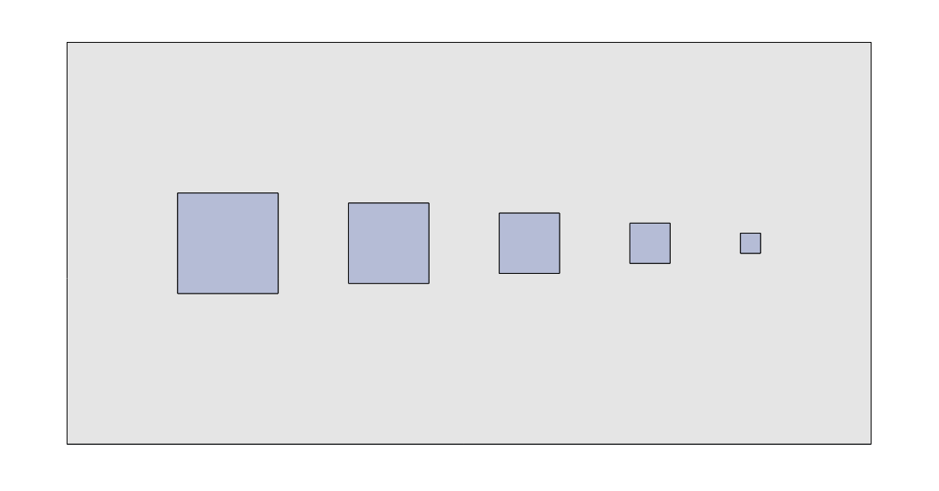
W = 40mm
L = 20mm
5mm
4mm
3mm
2mm
1mm

Slide 14
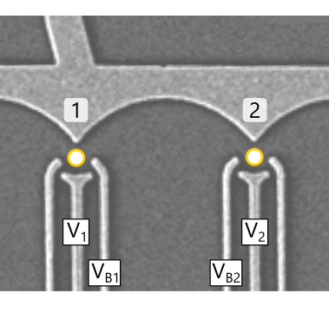
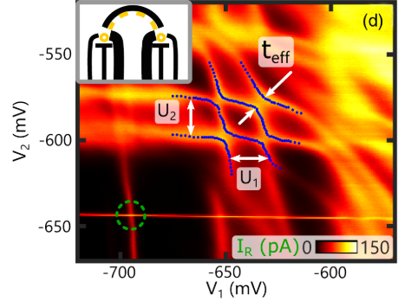
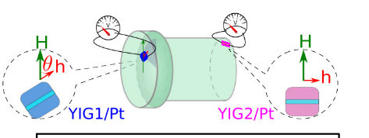
Why we are doing this research?
Cavity mediated coupling between two quantum dots
Cavity mediated coupling between two YIG film

Slide 15
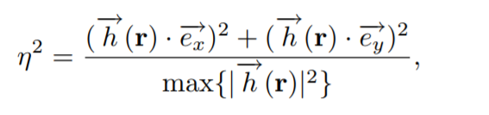
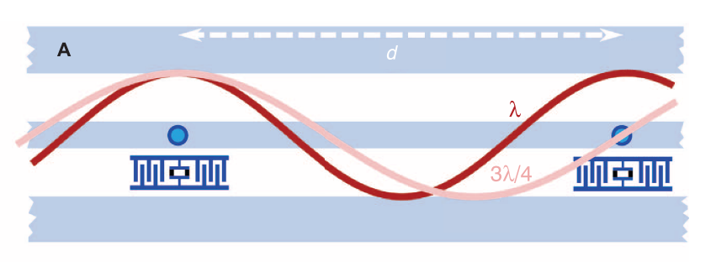
Why we are doing this research? (2)
Overlapping coefficient:

Slide 16
What this can be useful to others

